Slide 1
CT111 PROJECT
Name : Patel Aksh Bharatlal
St Id : 201901005
Date : 17 / 04 / 2020

Slide 2
Honor Code
The work that we are presenting is our own work.
We have not copied the work (the code, the results, etc.) that someone else has done.
Concepts, understanding and insights we will be describing are our own.
We make this pledge truthfully. We know that violation of this solemn pledge can carry grave consequences.
Help Taken :
I had taken help from my two friends like - how they had done something ? What results the are getting ? And is it matching with mine results ? And I worked accordingly.I had NOT copied anyone code nor did i ask anyone for their code.
Aksh Patel

Slide 3
Encoder Concept
I have used state machine based implementation.
In it I have used 4 states 00 , 01 ,10 11.
Every state will have two paths and paths will contain 1 input bit and 2 output bits
1 input bit contains either 0 or 1.
2 output bits will contain two parity bits for rate =1/2 coding.
My code runs for K=3; and rate = 1 / 2;
Generalizations :
1. My code will run for any length of input bits k.
2. To run my code for different values of K and rate , I have to do some minor changes like –
If K = 3 and rate = 1 / 3 then no of states will be 8 and there are 3 parity bits.
Yes , my code runs better for both in terms of time and it is memory efficient.
Run time of my code is ~3 min.

Slide 4
Encoder Code Snippet
e1=zeros(1,2*(k+2));
for i=1:k+2
if(i==1)
e1(1,1)=info_bits(1,1);
e1(1,2)=info_bits(1,1);
end
if(i==2)
e1(1,3)=mod(info_bits(1,1)+info_bits(1,2),2);
e1(1,4)=info_bits(1,2);
end
if(i>=3)
e1(1,i*2-1)=mod(info_bits(1,i)+info_bits(1,i-1)+info_bits(1,i-2),2);
e1(1,i*2)=mod(info_bits(1,i)+info_bits(1,i-2),2);
end
End
Info_bits (size = k+2;) - original message bits including 2 zeros at end.
e1 (size = 2*(k+2);) - encoded matrix
G1 = [1 1 1];
G2 = [1 0 1];

Slide 5
Decoder Concept
I had made a matrix named “pm” which contains all the path matrix values of all the states in the Trellis Diagram.
I had calculated path matrix starting from first column in the Trellis diagram and goes till end.
All the columns in the Trellis structure’s are rows in my code.
For eg : there are 4 rows in the trellis structure. So , in my code I had made 4 columns in matrix “pm”.
Traceback :
Starting from last row of matrix “pm” decoder will go till first row and decode one bit at each row.
At each row decoder will calculate two branch matrix of minimum path matrix state out of four possible state.
I had declared a variable named “m” which contains values in range (1,4) and it denotes the min path matrix state.
Initially m=1 and so in previous rows there are two states whose path comes into state m .
So It calculates branch matrix values of those two paths and chose min out of two state and assign variable “m” to the no. of that state.
Diagrammatic explanation is given in the next slide.

Slide 6
Traceback Diagrammatic Explanation
1 0 0 0 0 0
States path are : (from top to bottom)
1st row (1 0 , 0 1) 2nd row (0 0 , 1 1) 3rd row (0 1 , 1 0) 4th row (1 1 , 0 0)
Firstly m=1 , so it will first calculate two branch matrix that terminates into last single state (value = 4) and out of two it will select one path which has less branch matrix + path matrix of 1st and 3rd state. Then it changes m to 1 (because (4 + 2) > (4 + 0) so m=1) and it will decode last bit as 0.
Then similarly process will goes on till first bit is decode and m value keeps on changing.
Hence we are able to decode the received bit from last bit to first bit.
4
4
3
2
4
2
3
3
4
4
4

Slide 7
Decoder:
Branch Metric and Path Matrix Calculation Code Snippet
pm=zeros(k+2,4);
%----------------------Calculation of first row of path matrix--
pm(1,1)=abs(0-e1(1,1))+abs(0-e1(1,2));
pm(1,2)=abs(1-e1(1,1))+abs(1-e1(1,2));
pm(1,3)=10000;
pm(1,4)=10000;
%----------------------Calculation of rest rows of pth matrix -------
i1=0;
for i=2:k+2
pm(i,1) = min(pm(i-1,1) + e1(1,i1+3)-0 + e1(1,i1+4)-0,pm(i-1,3) + 1-e1(1,i1+3) + 1-e1(1,i1+4));
pm(i,2) = min(pm(i-1,1) + 1-e1(1,i1+3) + 1-e1(1,i1+4),pm(i-1,3) + e1(1,i1+3)-0 + e1(1,i1+4)-0);
pm(i,3) = min(pm(i-1,2) + 1-e1(1,i1+3) + e1(1,i1+4)-0,pm(i-1,4) + e1(1,i1+3)-0 + 1-e1(1,i1+4));
pm(i,4) = min(pm(i-1,2) + e1(1,i1+3)-0 + 1-e1(1,i1+4),pm(i-1,4) + 1-e1(1,i1+3) + e1(1,i1+4)-0);
i1=i1+2;
end
%------------f is the final matrix of calculation of path matrix--------------%
f=[0 100000 100000 100000;pm];
pm contains all the path matrix values at all the states.
f is the final matrix also containing the very first column in the trellis diagram.

Slide 8
Decoder: Trellis Traceback and Bit Decision Code Snippet
decoded_bits=zeros(1,k+2);
m=1;
i1=2*k+4-1;
for i=k+2:-1:2
if m==1
decoded_bits(1,i)=0;
q = f(i,1) + e1(1,i1)-0 + e1(1,i1+1)-0;
r = f(i,3) + 1-e1(1,i1) + 1-e1(1,i1+1);
if q<=r
m=1;
i1=i1-2;
continue;
else
m=3;
i1=i1-2;
continue;
end
end %-------------- end of m==1 if --------------

Slide 9
Continue
if m==2
decoded_bits(1,i)=1;
q = f(i,1) + 1-e1(1,i1) + 1-e1(1,i1+1);
r = f(i,3) + e1(1,i1)-0 + e1(1,i1+1)-0;
if q<=r
m=1;
i1=i1-2;
continue;
else
m=3;
i1=i1-2;
continue;
end
end %--------------end of m==2 if --------------
if m==3
decoded_bits(1,i)=0;
q = f(i,2) + 1-e1(1,i1) + e1(1,i1+1)-0;
r = f(i,4) + e1(1,i1)-0 + 1-e1(1,i1+1);
if q<=r
m=2;
i1=i1-2;
continue;
else
m=4;
i1=i1-2;
continue;
end
end %------------------end of m==3 if ---------------

Slide 10
Continue
if m==4
decoded_bits(1,i)=1;
q = f(i,2) + e1(1,i1)-0 + 1-e1(1,i1+1);
r = f(i,4) + 1-e1(1,i1) + e1(1,i1+1)-0;
if q<=r
m=2;
i1=i1-2;
continue;
else
m=4;
i1=i1-2;
continue;
end
end %-----------end of m==4 if---------------
End
%----------first bit decoding ----------------
if m==1
decoded_bits(1,1)=0;
else
decoded_bits(1,1)=1;
end

Slide 11
Monte Carlo Simulator: Code Snippet
clearvars;
close all;
rate=1/2;
snr_db=0:0.5:8;
snr_linear=10.^(snr_db./10);
sigma2=1./(2*rate.*snr_linear);
sigma = sqrt(sigma2);
sigmaset=sigma;
Nsim =20000;
sizeofsigma=size(sigma);
nerr=zeros(1,sizeofsigma(1,2));
perr=qfunc(sqrt(2*rate*snr_linear));
i11=0;
sum1=zeros(1,sizeofsigma(1,2));
for sig=sigmaset
i11=i11+1;
for ksim = 1:Nsim
k=500;
info_bits = randi([0 1],[1 k+2]); %------ declaring original message bit matrix--------
info_bits(1,k+1)=0;
info_bits(1,k+2)=0; %------ adding 2 trailing zeros -------------
%------ Encoding , channel , decoding part will be put here ------------------------------------
nerr(1,i11)=nerr(1,i11)+sum(xor(info_bits,decoded_bits));%--calculating error and store it into matrix
end
end

Slide 12
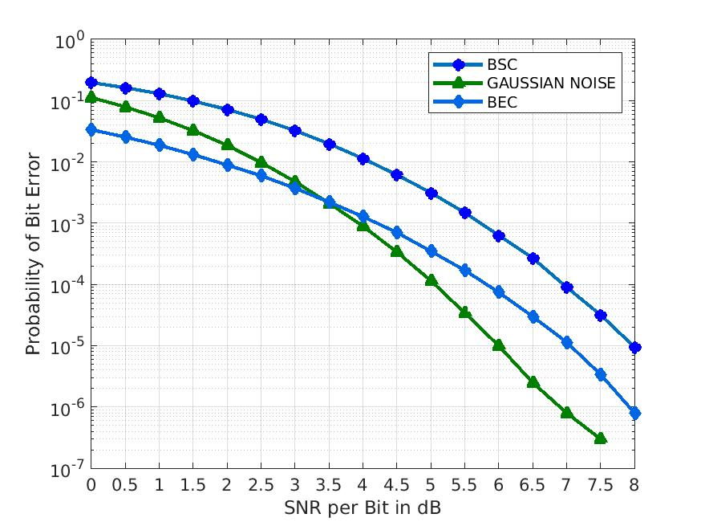
Numerical Result : Basic

Slide 13
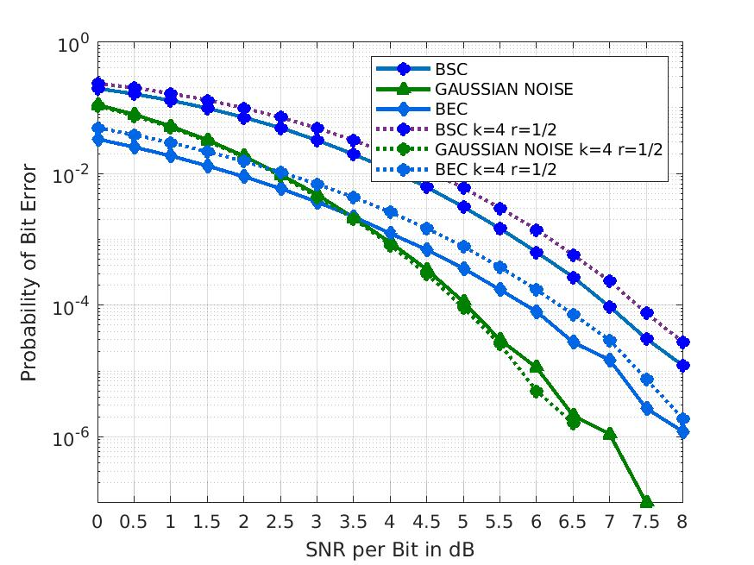
Numerical Result: Intermediate Rate=1/2 K=4

Slide 14
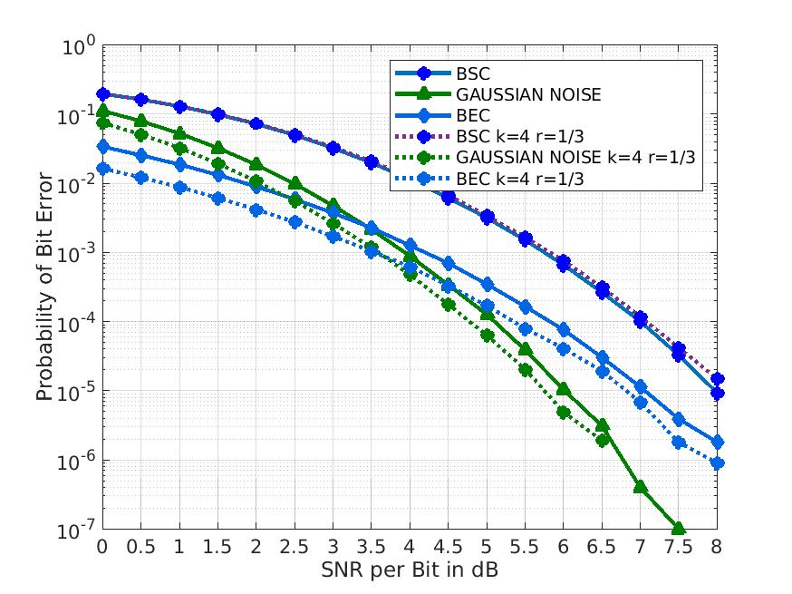
Numerical Result: Intermediate Rate=1/3 K=4

Slide 15
Summary
Difficulties faced :
1. In decoding part I spend a lot of time trying 3 to 4 logics which give best result and runs in less time.
2. In finding proper bit error rate . I go through the code many times to find my errors and try to fix it.
Rating of Project :
Moderately hard , very informative and quite similar to project in companies.
Helpful in many other Projects :
This type of algorithm is applicable to - 1). shortest path searching algorithm.
2). Finding traffic free road . ( first finding traffic with all possible paths and trace backing path with les traffic.

Slide 16
References
M. Valenti, \Channel Coding for IEEE 802.16e Mobile WiMAX," June 2009
H. Balakrishnan, J. White, \MIT 6.02 DRAFT Lecture Notes, Chapter 8, Convolution Coding,"Fall 2010 (Last update: October 4, 2010)
H. Balakrishnan, J. White, \MIT 6.02 DRAFT Lecture Notes, Chapter 9, Viterbi Decoding of Convolution Codes," Fall 2010 (Last update: October 6, 2010).
M. Valenti, \Channel Coding for IEEE 802.16e Mobile WiMAX," June 2009.
J. G. Proakis, \Digital Communications," third edition, 1994.

